Slide 1

BOOSTING ALGORITHM
Introduction of LG BOOSTING
Notes:
LGBM is a gradient boosting framework that uses tree-based learning algorithms. Some of its key features are: Faster training speed and higher efficiency than other gradient boosting algorithms. Lower memory usage and better accuracy than other gradient boosting algorithms.

Slide 2

PRINCIPLE OF LG BOOSTING
Notes:
The principle of LightGBM revolves around efficiency, scalability, and accuracy. It achieves this by utilizing innovative techniques such as leaf-wise tree growth, histogram-based algorithms, and efficient data handling to optimize memory usage and training time.

Slide 3

APPLICATION OF LG BOOSTING
Notes:
Light GBM is a fast, distributed, high-performance gradient boosting framework that uses a tree-based learning algorithm. It also supports GPU learning and is thus widely used for data science application development.

Slide 4
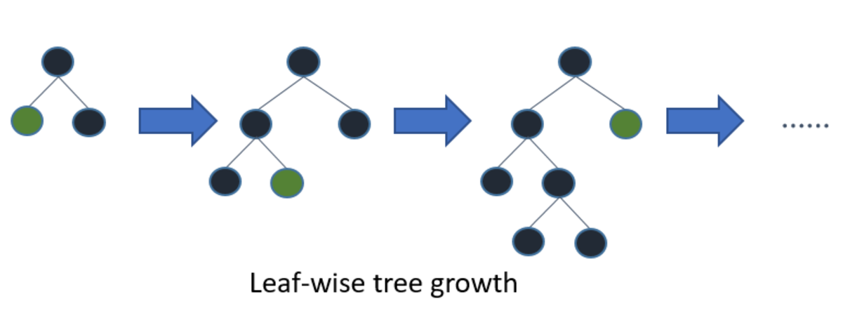
USES OF LG BOOSTING
Notes:
Faster training speed and higher efficiency: Light GBM uses a histogram-based algorithm i.e it buckets continuous feature values into discrete bins which fasten the training procedure.
Lower memory usage: Replaces continuous values to discrete bins which results in lower memory usage.

Slide 5

CONCLUSION OF LG BOOSTING
Notes:
Conclusion. LightGBM revolutionizes gradient boosting with its lightning-fast speed and tree-growth strategies, which makes it stand out from the field of machine learning.

Slide 6

ADVANTAGES AND DISADVANTAGES OF lg boosting
Notes:
Advantages: Faster Speed and Higher Accuracy: LightGBM algorithm offers faster training times and higher accuracy compared to other gradient boosting algorithms, making it suitable for large-scale datasets and time-sensitive applications.
Disadvantages: “Overfitting” Light GBM split the tree leaf-wise which can lead to overfitting as it produces much complex trees.

